Slide 1


Stress regulation via self-administered mindfulness and biofeedback interventions in adults: A pre-registered met a-analysis
14/09/2021 ESCON
Alessandro Sparacio
Ivan Ropovik
Gabriela M. Jiga-Boy
Patrick S. Forscher
Bastien Paris
Hans IJzerman

Slide 2


No evidence for Self-administered mindfulness and Biofeedback interventions
Notes:
In this talk I will present my meta-analysis and I will discuss how self-administered mindfulness and biofeedback, based on the evidence that we retrieved, cannot be considered reliable interventions to reduce stress.

Slide 3
- How we approach stress - Interventions and justifications for the meta-analysis - Results
Notes:
To show this I will define
How we approach stress,
I will define the intervention and justification for the meta-analysis
I will present the results

Slide 4

Meta-analysis
I will adress some important questions:
Is there support for the reduction of stress through
self-administered mindfulness and biofeedback?
For which components (physiological, emotional, cognitive) underpinning biofeedback and self-administered mindfulness is there adequate empirical support?
Are individual differences taken into account when it comes to
the efficacy of different stress regulation interventions?
Are there any features of these interventions that make
them more effective?
Notes:
I will also try to adress some important questions such as

Slide 5

How we approach stress
Notes:
Before going into the meta-analysis it is important to provide a definition of stress

Slide 6





Meta-analysis – theoretical framework
“Stress is a particular relationship between
the person
and the environment
that is appraised by the person as taxing or exceeding his or her resources and endangering his or her well-being” (Lazarus & Folkman, 1984, p. 19)
Notes:
To do that, we will borrow the definition of Lazarus and Folkman. According to them stress is

Slide 7

Meta-analysis – theoretical framework
Stress response
S
affective component:
feelings of nervousness,
strain, and tensions
cognitive component:
changes in cognitive functions (e.g., rumination)
STRESS
physiological component:
activation of the autonomic nervous system (e.g., changes in
heart-rate, heart-rate variability, cortisol)
Notes:
The response to stress can be thought of as separated in three different components: Affective, physiological and cognitive. we nevertheless agree with the theoretical position that these different types of response do not really present theoretical distinctions. But yet, splitting them into three different categories allows us to better understand the potential applied value of the stress-regulation strategies included in our work.

Slide 8

Meta-analysis – theoretical framework
Affective consequences of stress:
depression & trait anxiety
Notes:
When stress exceeds what one can handle, longer-term affective consequences may emerge, like depression or chronic anxiety and we did also an assessment of that in our meta-analysis

Slide 9

Interventions and justifications for the meta-analysis
Notes:
I will now present the interventions that have been included in my meta-analysis and the compelling reasons for which I decided to conduct this synthesis

Slide 10
Meta-analysis – theoretical framework
Self-administered mindfulness:
No instructor required
Available 24/7 to people on their own
Low cost
Notes:
The first strategy I included in my meta-analysis is Self-administered mindfulnes. this intervention shares features, such as a non-judgmental attitude and an acceptance of inner experience, with other mindfulness protocols. In contrast with other protocols, however, self-administered mindfulness does not require the presence of an instructor, is always available, and tends to be one of the least costly ones. Self-administered mindfulness can be administered via smartphone applications, audio files, and books which can guide the user through self-administered mindfulness exercises. In the empirical literature, a two week self-administered mindfulness meditation intervention (compared to a passive control group), has been found to influence the affective component by reducing self-reported stress.

Slide 11
Meta-analysis – theoretical framework
Biofeedback:
Self‐regulation technique through which individual learn to voluntarily control automatic bodily reactions and functions, implemented by computer-based programs which provide feedback on particular physiological processes (Frank et al., 2010).
Notes:
The second strategy, biofeedback, is a technique that allows people to have immediate feedback on a specific physiological function (such as heart-rate or muscle tension), that is under the control of the autonomic nervous system. Based on the biofeedback received, people can learn how to change a behavior (e.g., their breathing rate) in order to improve the particular function they are monitoring.

Slide 12
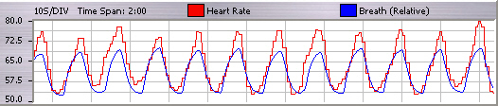
Meta-analysis – theoretical framework
Heart rate variability (HRV) biofeedback
HRV is a form of biofeedback therapy training that involves feeding back beat by beat heart rate data during slow breathing so that the breathing matches heart rate patterns. A biofeedback device shows the individuals when they have maximized this interaction on a computer monitor.
Notes:
For the present meta-analysis we have decided to focus on one type of biofeedback called Heart-Rate Variability biofeedback. Heart-Rate Variability biofeedback is, after all, the most used and thought to be the most efficacious in reducing stress. It trains individuals to maximize the interaction between breath and heart rate. when this happens there is an improvement in the vital function that is being monitored. in one study, six sessions of Heart-Rate Variability biofeedback (compared with an active control group) interventions improved symptoms of depression at post testing.

Slide 13
Meta-analysis – methods
Why are we conducting this meta-analysis?
There are no meta-analysis on self-administered mindfulness intervention
Update old meta-analyses on biofeedback (e.g., Goessl et al., 2017)
We applied a stringent analysis workflow to provide the best possible publication bias-corrected estimates
Notes:
We have compelling reasons for conducting this meta-analysis:
First, although there are meta-analyses on mindfulness, there are none on self-administered mindfulness.
Second, some meta-analyses on biofeedback exist, but they were conducted 4 years ago.
Third, prior meta-analyses applied now-outdated bias correction techniques like trim-and-fill, which is known to have an excessive false-positive rate under most realistic conditions.

Slide 14

Meta-analysis – methods
Analysis workflow:
Assessment of evidential value → p-curve analysis
Estimation of a naive meta-analysis effect and effect heterogeneity
We took into account any dependencies in the data and clustering effects
Correction of publication bias with 3PSM and PET-PEESE
We considered an effect to be present only if all of the meta-analytic techniques detected one
Notes:
We will apply more up-to-date meta-analyses techniques, such as variance estimation-based multilevel models with three publication bias correction techniques (p-curve, PET-PEESE, and the multiple-parameter selection model) that together provide a strict test of the concepts tested.
P-curve is a technique used to assess the evidential value in a set of significant findings
The 3 PSM is an implementation of selection methods, which are techniques that estimate and correct for publication biases regarding the size, direction, and statistical significance of study results.
PET-PEESE is a conditional regression-based meta-analytic model that aims to correct for publication bias
We considered an effect to be present only if all of the meta-analytic techniques detected one. Our approach was conservative, but provides a severe test of the theoretical principles tested. Crucially, our approach provides a more realistic estimate of the effect that could be expected in close replications of the studies included in this meta-analysis

Slide 15
Meta-analysis – methods
Stress regulation via self-administered mindfulness and biofeedback interventions in adults: A pre-registered meta-analysis
PICO framework
P → Adults
I → Self-administered mindfulness/ HRV biofeedback
C → Active/passive control condition
O → Stress response & affective consequences of
stress (e.g. trait anxiety or depression)
S → Randomized controlled trials and observational
Studies
Notes:
To frame our research question in a structured way, we followed the Participants, Intervention, Comparator, and Outcome (PICO) Framework (Schardt et al., 2007). We chose to only include studies on participants that are adults. We only included two interventions (self-administered mindfulness and biofeedback based on Heart-Rate Variability). For designs comparing groups, we included effects based on a comparison to an active control condition, meaning that participants are subjected to an alternative treatment for stress reduction or to a passive control condition, for instance wait list. The main outcome of this meta-analysis was the level of stress after intervention, divided into three components (affect, cognition, and physiology) and the affective consequences.

Slide 16
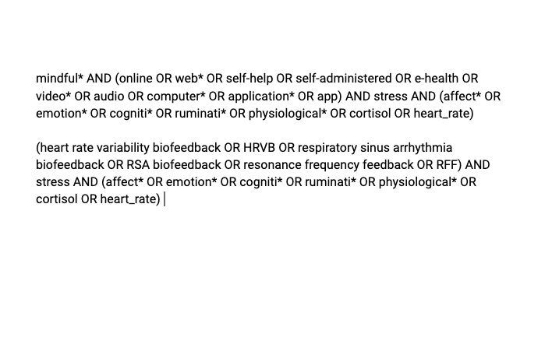
Meta-analysis – methods
Search strategy
Databases: ProQuest, PubMED,
and Scopus
Link: http://bit.ly/3nJYQY8
Notes:
we first did an initial search for either strategy to assess the search terms, then we adjusted according to the parameters of the databases. Beyond searching databases, we also contacted listservs and contacted authors that published on the topic before. You can find my search strategy in the bit.ly link that you can see in this slide.

Slide 17

Meta-analysis – methods
Meta-analysis pre-registered on OSF and PROSPERO
Link: http://bit.ly/39MifmH
PROSPERO ID number: CRD42020179810

Slide 18
Meta-analysis – results
Search results
total = 1056 Articles after duplicate removed: 592
Total articles included: 24
Total effects coded: 72
Total effects included: 35
total = 262 Articles after duplicate removed: 157
Total articles included: 19
Total effects coded: 42
Total effects included: 31
Notes:
Our search strategy resulted in a total effects of 31 for SAM and 28 for Biofeedback. The reason for removing for so many effects is because they did not fit our inclusion criteria defined by the pico.

Slide 19
Results: Self-administered mindfulness
Notes:
So, Is there any evidence for the reduction of stress based on self-administered mindfulness?

Slide 20
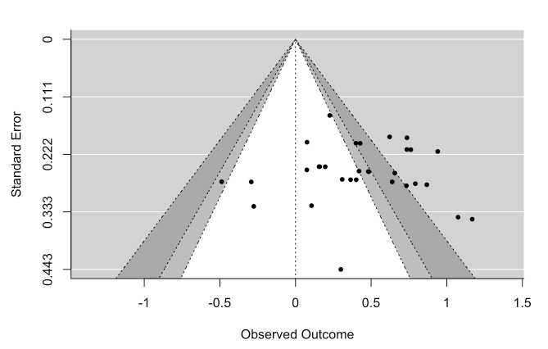
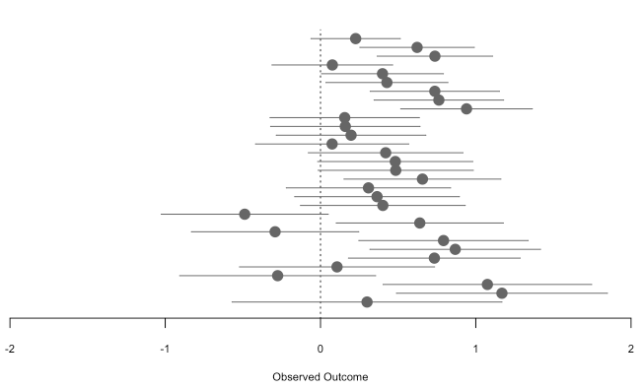
Meta-analysis – results
Results: Self-administered mindfulness
Coef Estimate = .41
SE = .08
CI [.22, .59]
Heterogeneity
Tau = .28
I^2 = 57.4 %
Notes:
The Random-effects meta-analysis indicated the presence of systematic, but highly heterogeneous true effects for self-administered mindfulness.
The funnel plot, that is the graph in the right, a scatterplot of treatment effect against the standard error . You can see that the distribution of the dots is asymetric and this may suggest the presence of publication bias.

Slide 21

Meta-analysis – results
Results: Self-administered mindfulness
Correction for publication bias
3PSM (g = .28, p =.11)
PET (g = .56, p =.24)
Notes:
Although with the naive meta-analytic estimate we found an effect, when we apply bias correction techniques we arrive to a different conclusion
Neither the 3PSM (g = .28, p =.11) nor PET (g = .56, p =.24) detected an effect for self-administered mindfulness.

Slide 22
Results: Biofeedback
Notes:
And as for biofeedback, Can we say that there is evidential value for this strategy?

Slide 23
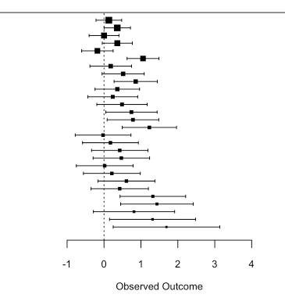

Meta-analysis – results
Results: Biofeedback
Coef Estimate = .5
SE = .10
CI [.29, .70]
Heterogeneity
Tau = .32
I^2 = 52.4 %
Notes:
A similar highly heterogeneous true effects was observed also for biofeedback.
Also in this case the funnel plot is asymettric suggesting the presence of publication bias.

Slide 24
Meta-analysis – results
Results: Self-administered mindfulness
Correction for publication bias
3PSM (g = .34, p =.15)
PET (g = -.64 , p =.023)
Notes:
Again there seems to be an effect, but when we apply publication bias techniques
Neither the 3PSM (g = .28, p =.11) nor PET (g = .56, p =.24) detected an effect for biofeedback

Slide 25
Meta-analysis – results
Results: Self-administered mindfulness
Results:
No difference as related to the component of the stress response or to the affective consequences of stress
Impossible to make inferences related to individual differences
Meditating one more day per week was significantly associated with a reduction in levels of stress (B = .06; t = 4.37; p < .001)
Having more biofeedback interventions per week helped stifling the build-up of stress (B = .12; t = 3.89; p < .001).
Notes:
As for the results
We did not found a difference as related to the component of the stress response or to the affective consequeneces of stress.
It was not possible to make inferences on an individual level because moderator analysis taking into account individual difference were mostly not performed in the study included in our meta-analysis.
we did also several subgroup analysis, without publication bias techniques. We found that ...
Thus the frequency seem to be one of the most important factor in reducing level of stress, however we must be cautious in interpreting this result because of the impossibility of applying publication bias techniques for the low number of effects for this subgroup analyses.

Slide 26
Meta-analysis – conclusions
Conclusions:
No evidential value for both strategies
Presence of publication bias in both strategies
The studies on the named strategies are largely underpowered to detect a small effect size.
For some subgroup analyses too few effects were gathered to derive conclusive interpretations (especially with k <10)
Notes:
As for the conclusions: ...

Slide 27

Meta-analysis – recommendations
Recommendations:
Better powered and pre-registered studies need to be conducted in order to assess the efficacy of these strategies
It is essential to develop a protocol for both self-administered
mindfulness and biofeedback
Individual differences must be taken into account when it comes
to evaluate the efficacy of these strategies (e.g., trait anxiety)
Notes:
With the state of the literature in this shape,

Slide 28




Meta-analysis
Questions or comments?
Contact me:
@Alessan09558632
Alessandro Sparacio
ale.sparacio92@gmail.com
Notes:
That's all. Please let me know if you have any questions, or any thoughts. I’d love to chat with you more about this project. Contact me on twitter, linkedin or send me an email as you prefer.

Slide 29




Thank you for listening
https://corelab.io
Notes:
Thanks again, I hope you enjoy the rest of the conference. Ciao!

Slide 30
Thank you for listening
https://corelab.io

